Slide 1
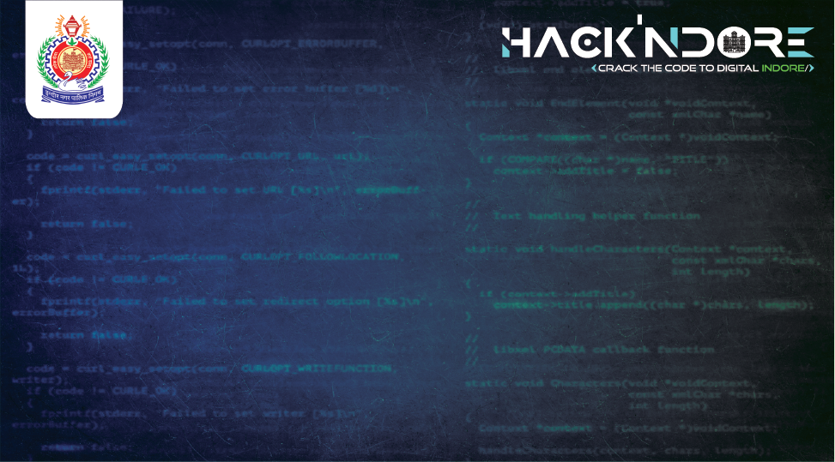





Water Supply Management System
Threat Trackers
9:41
Sarthak Mittal
Vinayak C.
Rajeev Parmar
Manas Jain

Slide 2

A portal in water management systems provides a centralized online platform for users to access real-time data, reports, and management tools. It facilitates communication, monitoring, and decision-making by integrating information from various sources for efficient water distribution and management.
Portal
Lack of Household-Level Monitoring
A National Pipeline Mapping System in water management uses GIS technology to map and monitor pipelines. It helps in planning, maintenance, leak detection, and emergency response, ensuring efficient water distribution and infrastructure management across the country.
The city has no infrastructure to monitor water distribution at the household level.
National Pipeline Mapping system
Research Analysis
Water Supply Management System
Water Wastage or Leakages
We thoroughly worked on problem statement and break it into smaller problem statements
Without household-level monitoring, it is difficult to identify and address water wastage or leakages
IoT in water management systems uses connected sensors and devices to monitor water levels, quality, and consumption in real-time. This data helps optimize distribution, detect leaks, predict maintenance needs, and ensure efficient and equitable water supply.
IOT
Absence of a Tracking Mechanism and Lack of Data for Decision-Making:
The absence of a tracking mechanism and continuous data collection on water usage per household makes it hard to ensure equitable water distribution.
AI Based System
Real-time monitoring in water management systems involves using sensors and IoT devices to continuously collect and analyze data on water usage, distribution, and quality. This enables immediate detection of issues, equitable distribution, and informed decision-making for system improvements.
Jal Sanjivani A.I

Slide 3
Water Supply Management System
Wastage/Leakages
Prediction Model
Unequal Distribution
User, IoT Based Data
Data Deficiency
Realtime Response Portal
No Household Monitoring
AI + IoT
Realtime Monitoring
Management Inefficiency
Feedback Based AI
No Data Collection
Smart NPD
No Usage Reporting
IoT Model
Jal Sanjivani A.I
Notes:
Map + IoT

Slide 4
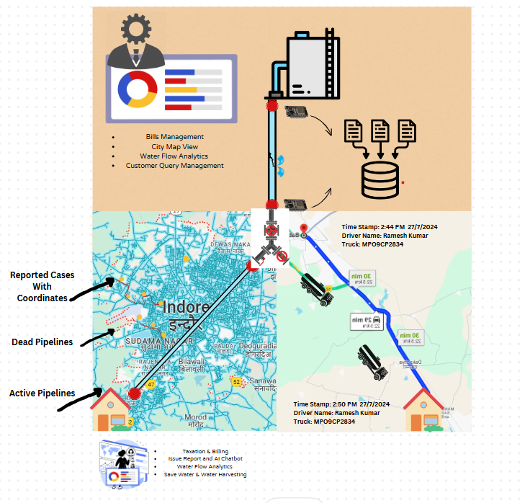
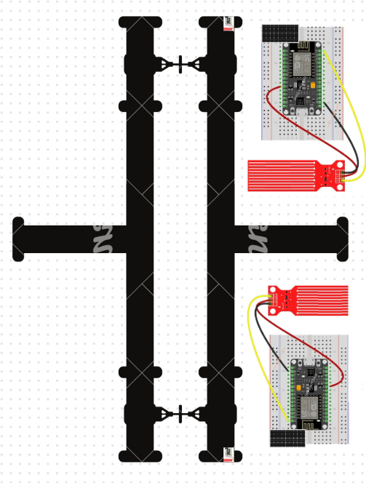
Jal Sanjivani A.I
Notes:
Portal slide

Slide 5
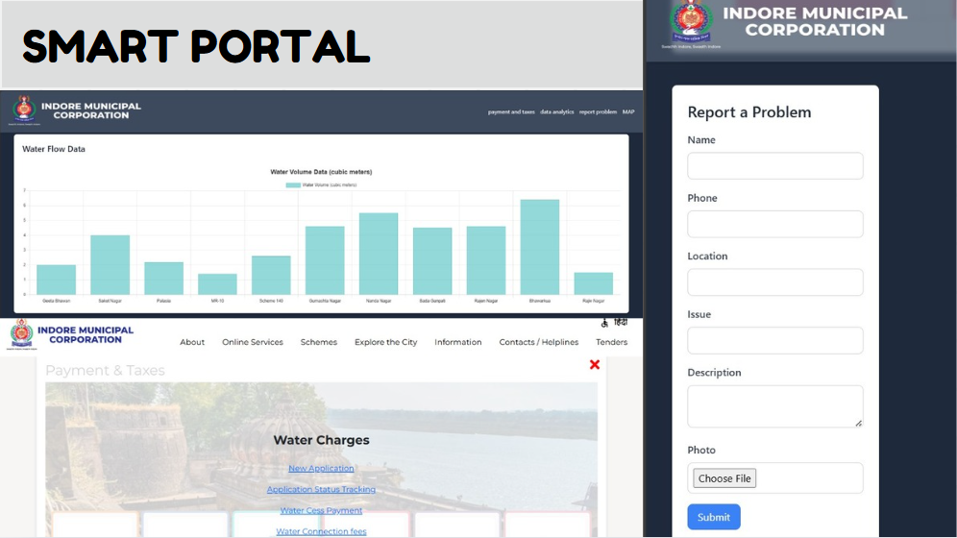
Jal Sanjivani A.I
Notes:
Portal slide

Slide 6
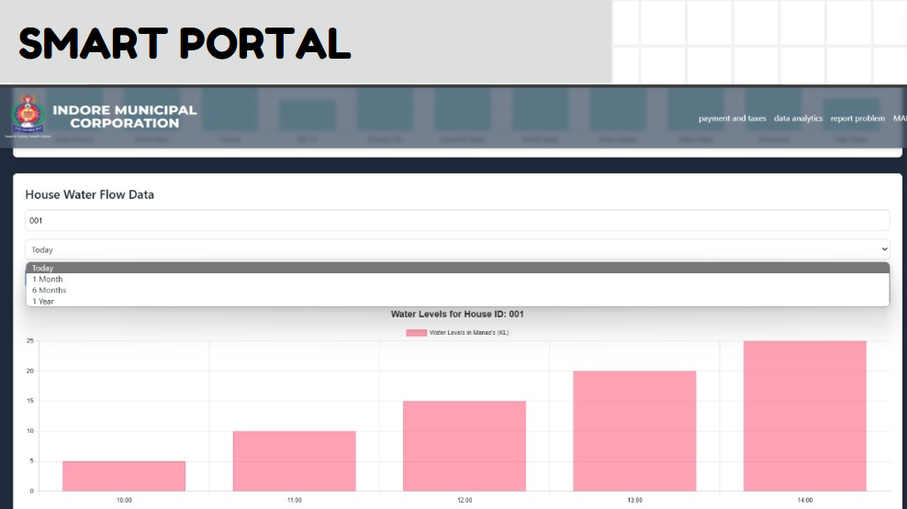
Jal Sanjivani A.I
Notes:
Portal slide

Slide 7
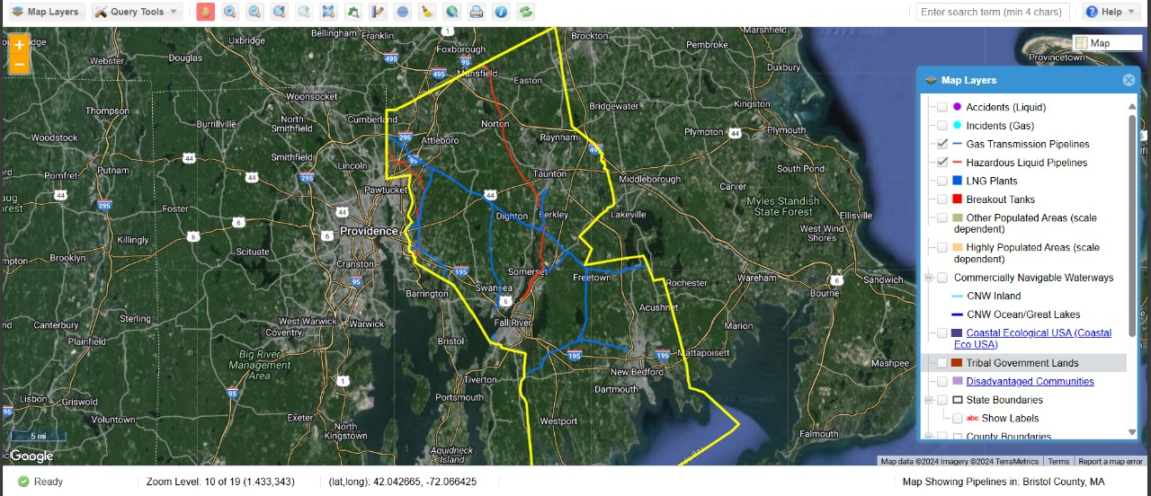
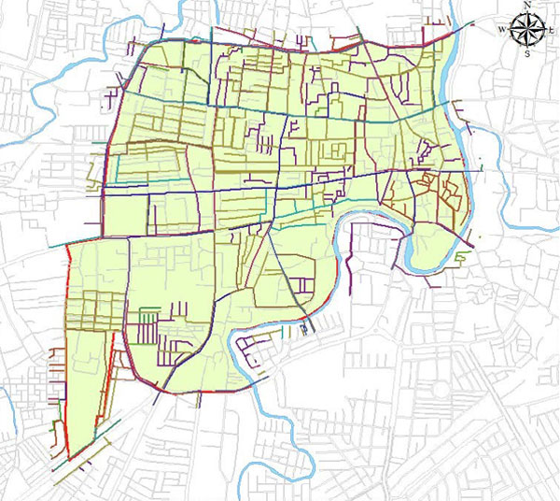


Jal Sanjivani A.I
Notes:
Portal slide

Slide 8


Jal Sanjivani A.I

